Slide 1
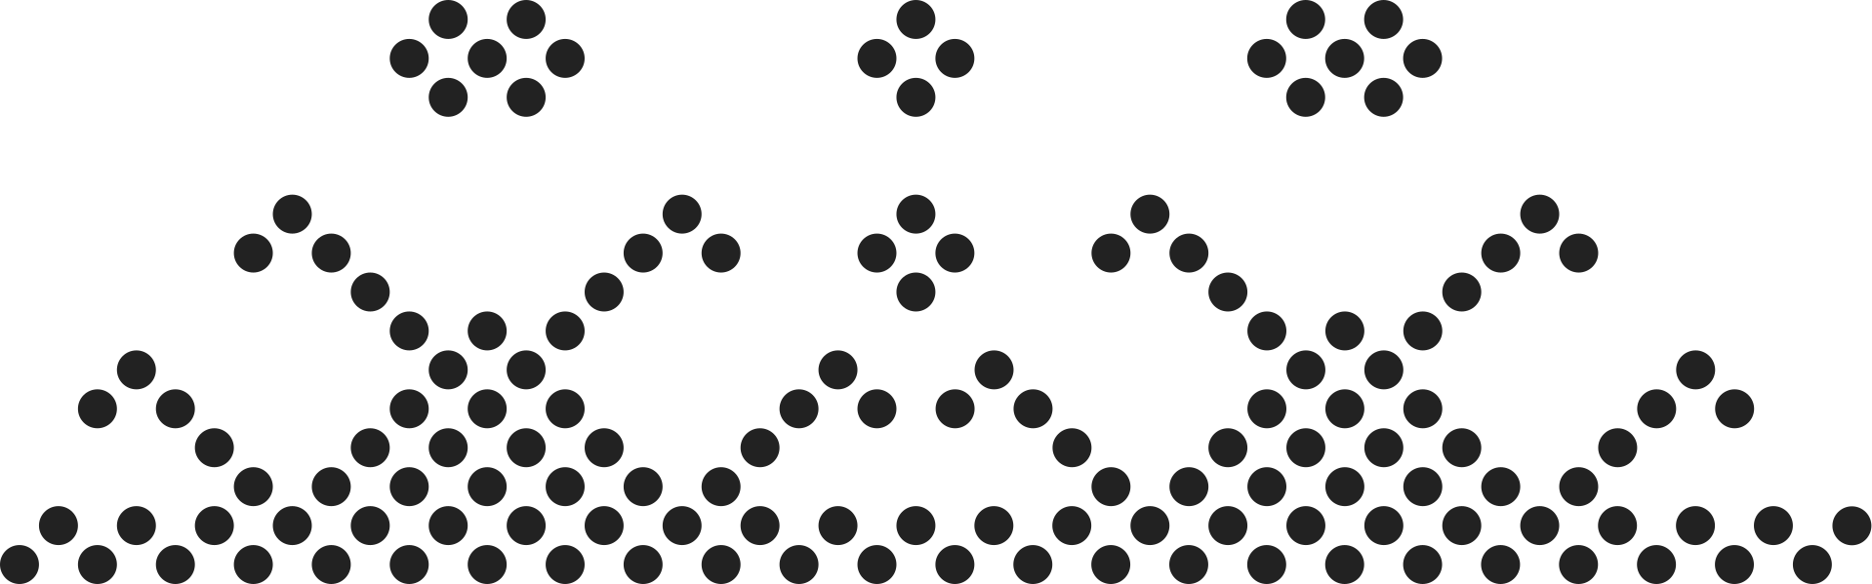
AdaDelta & Adam
Optimizer Algorithm
presented by
Nguyen Quoc Hung - 2470889

Slide 2
Introduction to Problem
Pre-requisites
Why we need AdaDelta & Adam
Introduction to AdaGrad
Introduction to EMA
AdaDelta - AdaGrad’s Improvement
Adam
Introduction
Mathematic Formula
Limitation
Introduction
Mathematic Formula
Limitation
Outline
Conclusion

Slide 3
Core Problem
Challenges with normal gradient algorithms such as Stochastic Gradient Descent (SGD):
Difficult Navigation: Local minima and saddle points can trap the optimizer, leading to suboptimal solutions.
Gradient Scaling Issues: Vanishing or exploding gradients in deep networks.
Inflexible Learning Rate: A single, fixed learning rate is inefficient and hard to tune.
The adaptive methods like AdaDelta & ADAM can help us

Slide 4
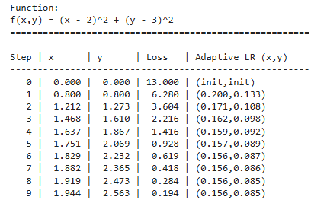


Pre-requisites: AdaGrad
AdaGrad is an optimization algorithm that is designed to adapt the learning rate for each parameter. It is beneficial for sparse features
Accumulator calculation
Final parameter

Slide 5

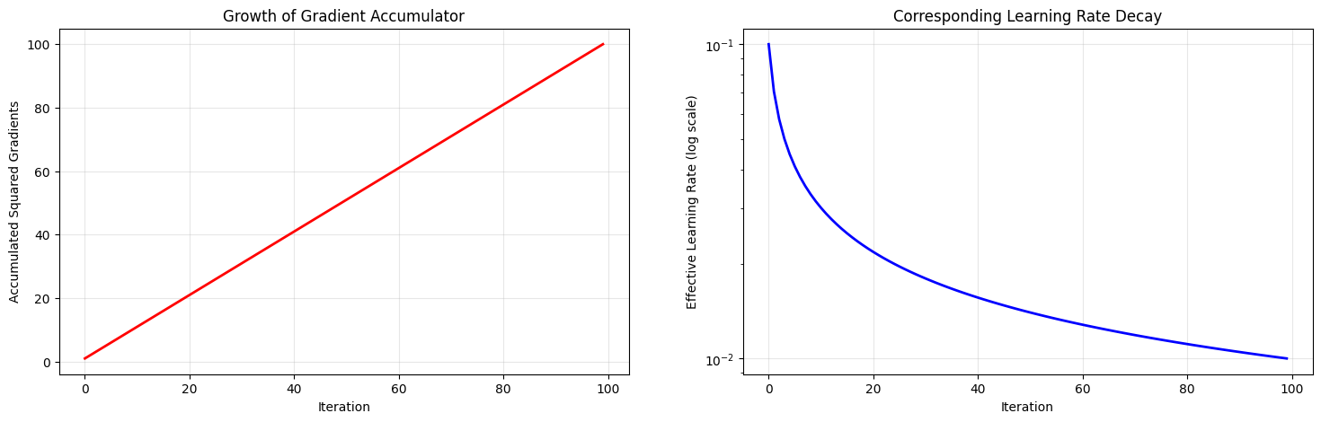
AdaGrad Limitation

Slide 6

Exponential Moving Avevage (EMA)
EMA stands for Exponential Moving Average
It is a statistical method used to create a smoothed average of a sequence of data
EMA is used to stabilize training by placing more weight on the most recent data points, with the influence of older points decreasing exponentially over time
The EMA can be expressed within this formula

Slide 7



AdaDelta
AdaDelta addresses AdaGrad’s decaying learning rate by using an Exponential Moving Average (EMA) of gradients
It uses 2 EMAs parameters:
Average of Past Squared Gradient
Average of Past Squared Updates
Where:

Slide 8

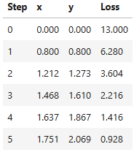
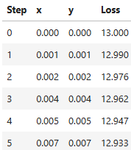
AdaDelta - Limitation
Function
AdaGrad results
AdaDelta results

Slide 9


Adam
ADAM algorithm is a comprehensive optimization method that combine several effective techniques into one.
It use mini-batching for efficient processing
Momentum to accelerate convergence by using the past gradients
per-parameter scaling to adjust the learning rate for each parameter
It uses 2 EMAs parameters as well:
Tracks direction of the updates
Track the variance of the gradients

Slide 10


Adam - Bias Correction
Since the initial bias of its moving average estimates toward zero, which can be small during the first few steps of training
=> Bias correction is used to scale them up, which ensures the step sizes are appropriately large and estimate are more accurate from the beginning
Bias correction of s_t & v_t
Rescaled gradients

Slide 11

Adam - Yogi Improvement
Within the second moment
As the g_t becomes very large, noisy, and infrequent, this can lead to the learning rate being minimal => Consequently, Adam will lose its memory of the historical gradient magnitudes and the model can not converge properly
Yogi improvement

Slide 12
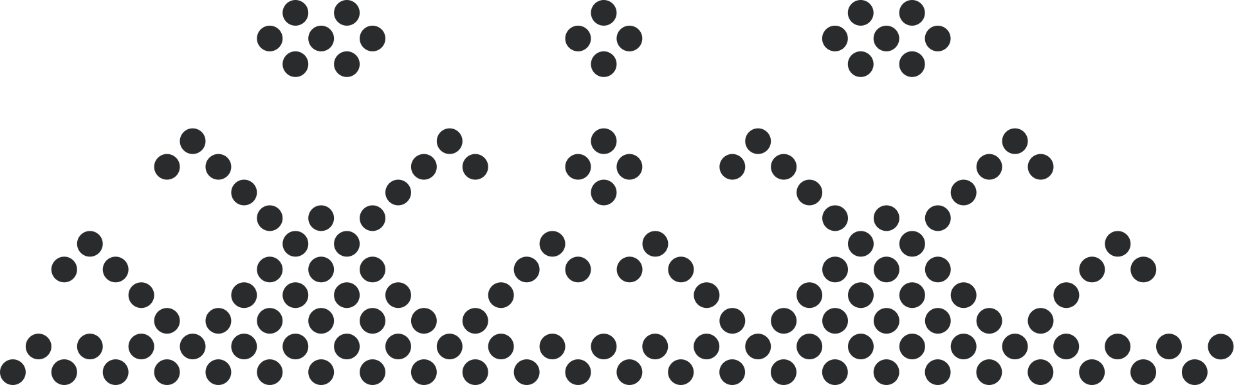
Conclusion
ADADelta → No need to set a learning rate manually.
Strengths:
Simplifies training with minimal hyperparameter tuning.
Effective for tasks with sparse gradients.
Weaknesses:
Convergence can be slower and less stable in complex scenarios.
ADAM (Adaptive Moment Estimation) → Combines momentum with adaptive learning rates and includes bias correction.
Strengths:
Robust, fast, and highly reliable.
One of the most widely used optimizers today.
Key Takeaway
ADAM is the recommended default optimizer for most deep learning applications due to its speed and reliability.
ADADelta remains a valuable option for specific cases where minimal tuning is the highest priority.

Slide 13
Thank You
for
Listening !!!

